Slide 1
List Comprehensions

Slide 2
List Comprehensions
List comprehensions in Python are concise, syntactic constructs. They can be utilized to generate lists from other lists by applying functions to each element in the list. The following section explains and demonstrates the use of these expressions.
A list comprehension creates a new list by applying an expression to each element of an iterable. The most basic form is:
[ <expression> for <element> in <iterable> ]
There's also an optional 'if' condition:
[ <expression> for <element> in <iterable> if <condition> ]
Each <element> in the <iterable> is plugged in to the <expression> if the (optional) <condition>evaluates to true . All results are returned at once in the new list. Generator expressions are evaluated lazily, but list comprehensions evaluate the entire iterator immediately - consuming memory proportional to the iterator's length.
To create a list of squared integers:
squares = [x * x for x in (1, 2, 3, 4)]
# squares: [1, 4, 9, 16]

Slide 3
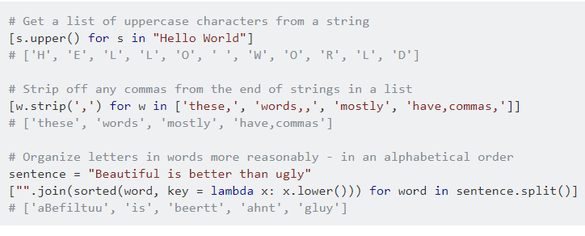
The for expression sets x to each value in turn from (1, 2, 3, 4). The result of the expression x * xis appended to an internal list. The internal list is assigned to the variable squares when completed.
Besides a speed increase (as explained here), a list comprehension is roughly equivalent to the following for-loop:
squares = []
for x in (1, 2, 3, 4):
squares.append(x * x)
# squares: [1, 4, 9, 16]
The expression applied to each element can be as complex as needed:

Slide 4
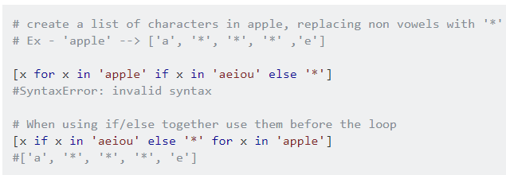
else
else can be used in List comprehension constructs, but be careful regarding the syntax. The if/else clauses should be used before for loop, not after:
Note this uses a different language construct, a conditional expression, which itself is not part of the comprehension syntax. Whereas the if after the for…in is a part of list comprehensions and used to filter elements from the source iterable.

Slide 5
Double Iteration
Order of double iteration [... for x in ... for y in ...] is either natural or counter-intuitive. The rule of thumb is to follow an equivalent for loop:
def foo(i):
return i, i + 0.5
for i in range(3):
for x in foo(i):
yield str(x)
This becomes:
[str(x)
for i in range(3)
for x in foo(i)
]
This can be compressed into one line as [str(x) for i in range(3) for x in foo(i)]

Slide 6
In-place Mutation and Other Side Effects
Before using list comprehension, understand the difference between functions called for their side effects (mutating, or in-place functions) which usually return None, and functions that return an interesting value.
Many functions (especially pure functions) simply take an object and return some object. An in-place function modifies the existing object, which is called a side effect. Other examples include input and output operations such as printing.

Slide 7
list.sort() sorts a list in-place (meaning that it modifies the original list) and returns the value None. Therefore, it won't work as expected in a list comprehension:
[x.sort() for x in [[2, 1], [4, 3], [0, 1]]]
# [None, None, None]
Instead, sorted() returns a sorted list rather than sorting in-place:
[sorted(x) for x in [[2, 1], [4, 3], [0, 1]]]
# [[1, 2], [3, 4], [0, 1]]
Using comprehensions for side-effects is possible, such as I/O or in-place functions. Yet a for loop is usually more readable. While this works in Python 3:
[print(x) for x in (1, 2, 3)]
Instead use:
for x in (1, 2, 3):
print(x)

Slide 8
In some situations, side effect functions are suitable for list comprehension. random.randrange() has the side effect of changing the state of the random number generator, but it also returns an interesting value. Additionally, next() can be called on an iterator.
The following random value generator is not pure, yet makes sense as the random generator is reset every time the expression is evaluated:
from random import randrange
[randrange(1, 7) for _ in range(10)]
# [2, 3, 2, 1, 1, 5, 2, 4, 3, 5]

Slide 9
Whitespace in list comprehensions
More complicated list comprehensions can reach an undesired length, or become less readable. Although less common in examples, it is possible to break a list comprehension into multiple lines like so:
[
x for x
in 'foo'
if x not in 'bar'
]

Slide 10
Avoid repetitive and expensive operations using conditional clause
Consider the below list comprehension:
>>> def f(x):
... import time
... time.sleep(.1) # Simulate expensive function
... return x**2
>>> [f(x) for x in range(1000) if f(x) > 10]
[16, 25, 36, ...]
This results in two calls to f(x) for 1,000 values of x: one call for generating the value and the other for checking the if condition. If f(x) is a particularly expensive operation, this can have significant performance implications. Worse, if calling f() has side effects, it can have surprising results.

Slide 11
Instead, you should evaluate the expensive operation only once for each value of x by generating an intermediate iterable (generator expression) as follows:
>>> [v for v in (f(x) for x in range(1000)) if v > 10]
[16, 25, 36, ...]
Or, using the builtin map equivalent:
>>> [v for v in map(f, range(1000)) if v > 10]
[16, 25, 36, ...]
Another way that could result in a more readable code is to put the partial result (v in the previous example) in an iterable (such as a list or a tuple) and then iterate over it. Since v will be the only element in the iterable, the result is that we now have a reference to the output of our slow function computed only once:
>>> [v for x in range(1000) for v in [f(x)] if v > 10]
[16, 25, 36, ...]

Slide 12
However, in practice, the logic of code can be more complicated and it's important to keep it readable. In general, a separate generator function is recommended over a complex one-liner:
>>> def process_prime_numbers(iterable):
... for x in iterable:
... if is_prime(x):
... yield f(x)
...
>>> [x for x in process_prime_numbers(range(1000)) if x > 10]
[11, 13, 17, 19, ...]
Another way to prevent computing f(x) multiple times is to use the @functools.lru_cache()(Python 3.2+) decorator on f(x). This way since the output of f for the input x has already been computed once, the second function invocation of the original list comprehension will be as fast as a dictionary lookup. This approach uses memoization to improve efficiency, which is comparable to using generator expressions.

Slide 13
Say you have to flatten a list
l = [[1, 2, 3], [4, 5, 6], [7], [8, 9]]
Some of the methods could be:
reduce(lambda x, y: x+y, l)
sum(l, [])
list(itertools.chain(*l))
However list comprehension would provide the best time complexity.
[item for sublist in l for item in sublist]
The shortcuts based on + (including the implied use in sum) are, of necessity, O(L^2) when there are L sublists -- as the intermediate result list keeps getting longer, at each step a new intermediate result list object gets allocated, and all the items in the previous intermediate result must be copied over (as well as a few new ones added at the end).

Slide 14
Dictionary Comprehensions
A dictionary comprehension is similar to a list comprehension except that it produces a dictionary object instead of a list.
A basic example:
Python 2.x2.7
{x: x * x for x in (1, 2, 3, 4)}
# Out: {1: 1, 2: 4, 3: 9, 4: 16}
which is just another way of writing:
dict((x, x * x) for x in (1, 2, 3, 4))
# Out: {1: 1, 2: 4, 3: 9, 4: 16}

Slide 15
As with a list comprehension, we can use a conditional statement inside the dict comprehension to produce only the dict elements meeting some criterion.
Python 2.x2.7
{name: len(name) for name in ('Stack', 'Overflow', 'Exchange') if len(name) > 6}
# Out: {'Exchange': 8, 'Overflow': 8}
Or, rewritten using a generator expression.
dict((name, len(name)) for name in ('Stack', 'Overflow', 'Exchange') if len(name) > 6)
# Out: {'Exchange': 8, 'Overflow': 8}

Slide 16
Starting with a dictionary and using dictionary comprehension as a key-value pair filter
Python 2.x2.7
initial_dict = {'x': 1, 'y': 2}
{key: value for key, value in initial_dict.items() if key == 'x'}
# Out: {'x': 1}

Slide 17
Switching key and value of dictionary (invert dictionary)
If you have a dict containing simple hashable values (duplicate values may have unexpected results):
my_dict = {1: 'a', 2: 'b', 3: 'c'}
and you wanted to swap the keys and values you can take several approaches depending on your coding style:
swapped = {v: k for k, v in my_dict.items()}
swapped = dict((v, k) for k, v in my_dict.iteritems())
swapped = dict(zip(my_dict.values(), my_dict))
swapped = dict(zip(my_dict.values(), my_dict.keys()))
swapped = dict(map(reversed, my_dict.items()))
print(swapped)
# Out: {a: 1, b: 2, c: 3}

Slide 18
Merging Dictionaries
Combine dictionaries and optionally override old values with a nested dictionary comprehension.
dict1 = {'w': 1, 'x': 1}
dict2 = {'x': 2, 'y': 2, 'z': 2}
{k: v for d in [dict1, dict2] for k, v in d.items()}
# Out: {'w': 1, 'x': 2, 'y': 2, 'z': 2}
However, dictionary unpacking (PEP 448) may be a preferred.
Python 3.x3.5
{**dict1, **dict2}
# Out: {'w': 1, 'x': 2, 'y': 2, 'z': 2}

Slide 19
Generator Expressions
Generator expressions are very similar to list comprehensions. The main difference is that it does not create a full set of results at once; it creates a generator object which can then be iterated over.
For instance, see the difference in the following code:
# list comprehension
[x**2 for x in range(10)]
# Output: [0, 1, 4, 9, 16, 25, 36, 49, 64, 81]
Python 2.x2.4
# generator comprehension
(x**2 for x in xrange(10))
# Output: <generator object <genexpr> at 0x11b4b7c80>
These are two very different objects:
the list comprehension returns a list object whereas the generator comprehension returns a generator.
generator objects cannot be indexed and makes use of the next function to get items in order.

Slide 20
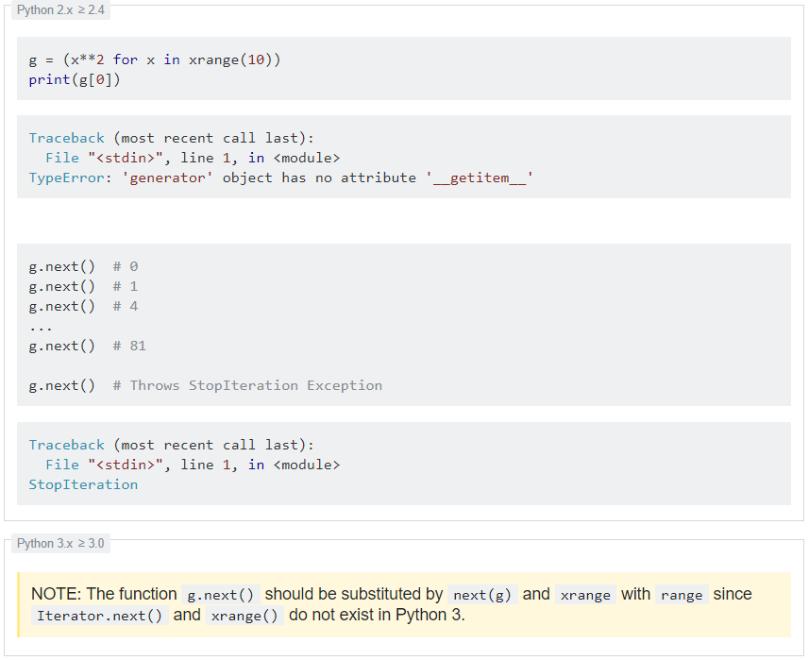
Note: We use xrange since it too creates a generator object. If we would use range, a list would be created. Also, xrange exists only in later version of python 2. In python 3, range just returns a generator. For more information, see the Differences between range and xrange functions example.

Slide 21
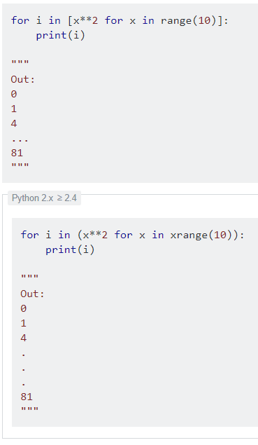
Although both of these can be iterated in a similar way:

Slide 22
Use cases
Generator expressions are lazily evaluated, which means that they generate and return each value only when the generator is iterated. This is often useful when iterating through large datasets, avoiding the need to create a duplicate of the dataset in memory:
for square in (x**2 for x in range(1000000)):
#do something

Slide 23
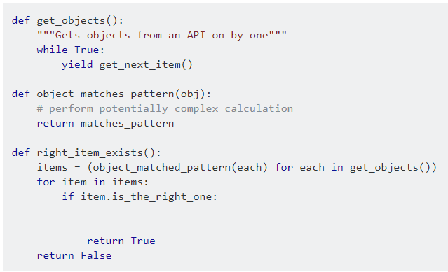
Another common use case is to avoid iterating over an entire iterable if doing so is not necessary. In this example, an item is retrieved from a remote API with each iteration of get_objects(). Thousands of objects may exist, must be retrieved one-by-one, and we only need to know if an object matching a pattern exists. By using a generator expression, when we encounter an object matching the pattern.

Slide 24
Set Comprehensions
Set comprehension is similar to list and dictionary comprehension, but it produces a set, which is an unordered collection of unique elements.
Python 2.x2.7
# A set containing every value in range(5):
{x for x in range(5)}
# Out: {0, 1, 2, 3, 4}
# A set of even numbers between 1 and 10:
{x for x in range(1, 11) if x % 2 == 0}
# Out: {2, 4, 6, 8, 10}
# Unique alphabetic characters in a string of text:
text = "When in the Course of human events it becomes necessary for one people..."
{ch.lower() for ch in text if ch.isalpha()}
# Out: set(['a', 'c', 'b', 'e', 'f', 'i', 'h', 'm', 'l', 'o',
# 'n', 'p', 's', 'r', 'u', 't', 'w', 'v', 'y'])

Slide 25
Comprehensions involving tuples
The for clause of a list comprehension can specify more than one variable:
[x + y for x, y in [(1, 2), (3, 4), (5, 6)]]
# Out: [3, 7, 11]
[x + y for x, y in zip([1, 3, 5], [2, 4, 6])]
# Out: [3, 7, 11]
This is just like regular for loops:
for x, y in [(1,2), (3,4), (5,6)]:
print(x+y)
# 3
# 7
# 11

Slide 26
Counting Occurrences Using Comprehension
When we want to count the number of items in an iterable, that meet some condition, we can use comprehension to produce an idiomatic syntax:
# Count the numbers in `range(1000)` that are even and contain the digit `9`:
print (sum(
1 for x in range(1000)
if x % 2 == 0 and
'9' in str(x)
))
# Out: 95

Slide 27
The basic concept can be summarized as:
Iterate over the elements in range(1000).
Concatenate all the needed if conditions.
Use 1 as expression to return a 1 for each item that meets the conditions.
Sum up all the 1s to determine number of items that meet the conditions.
Note: Here we are not collecting the 1s in a list (note the absence of square brackets), but we are passing the ones directly to the sum function that is summing them up. This is called a generator expression, which is similar to a Comprehension.

Slide 28
Changing Types in a List
Quantitative data is often read in as strings that must be converted to numeric types before processing. The types of all list items can be converted with either a List Comprehension or the map() function.
# Convert a list of strings to integers.
items = ["1","2","3","4"]
[int(item) for item in items]
# Out: [1, 2, 3, 4]
# Convert a list of strings to float.
items = ["1","2","3","4"]
map(float, items)
# Out:[1.0, 2.0, 3.0, 4.0]

Slide 29
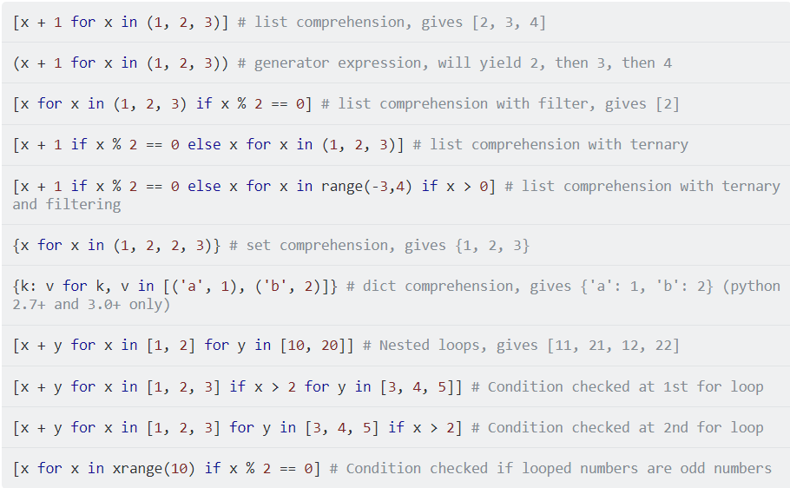
Code snippets

Slide 30
FIRST CHARACTER OF EVERY WORD IN A SENTENCE
[w[0] for w in phrase.split()]
['O', 's', 't', 'l', 'n', 'g', 't', 'C', 'I', 'i', 'a', 's', 'p']
SUBSTITUTE ALL VOWELS IN A SENTENCE BY THE CHARACTER ‘0’
"".join([c if c not in vowels else '0' for c in phrase])
"On s0c0nd th00ght, l0t's n0t g0 t0 C0m0l0t. It 0s 0 s0lly pl0c0."
PAIRS OF ELEMENTS DRAWN FROM DIFFERENT LISTS
words1 = ['Lancelot', 'Robin', 'Galahad']
words2 = ['Camelot', 'Assyria']
[(w1,w2) for w1 in words1 for w2 in words2]
[('Lancelot', 'Camelot'), ('Lancelot', 'Assyria'), ('Robin', 'Camelot'), ('Robin', 'Assyria'), ('Galahad', 'Camelot'), ('Galahad', 'Assyria')]
SQUARE ALL NON-NEGATIVE NUMBERS SMALLER THAN 10
[x**2 for x in range(10)]
[0, 1, 4, 9, 16, 25, 36, 49, 64, 81]
NON-NEGATIVE MULTIPLES OF 5 SMALLER THAN 100
[x for x in range(100) if x%5 == 0]
[0, 5, 10, 15, 20, 25, 30, 35, 40, 45, 50, 55, 60, 65, 70, 75, 80, 85, 90, 95]
NON-NEGATIVE MULTIPLES OF 3 BUT NOT MULTIPLES OF 6 SMALLER THAN 50
[x for x in range(50) if x%3 == 0 and x%6 != 0]
[3, 9, 15, 21, 27, 33, 39, 45]
ALL CONSONANTS IN A GIVEN SENTENCE (WITHOUT REPETITION)
import string
punct = string.punctuation + ' '
vowels = "aeiou"
phrase = "On second thought, let's not go to Camelot. It is a silly place."
set([c for c in phrase.lower() if c not in vowels and c not in punct])
{'c', 'd', 'g', 'h', 'l', 'm', 'n', 'p', 's', 't', 'y'}

